Slide 1
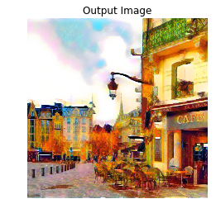
Style Transfer
Lucas DENELE, Henri HOYEZ & Zoé MOULART

Slide 2

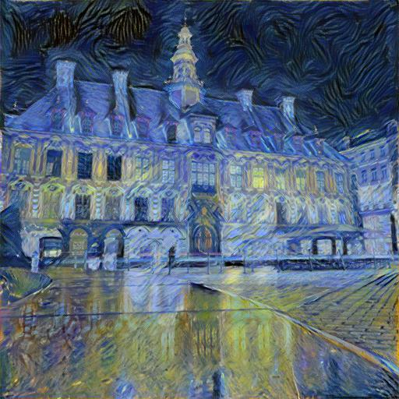
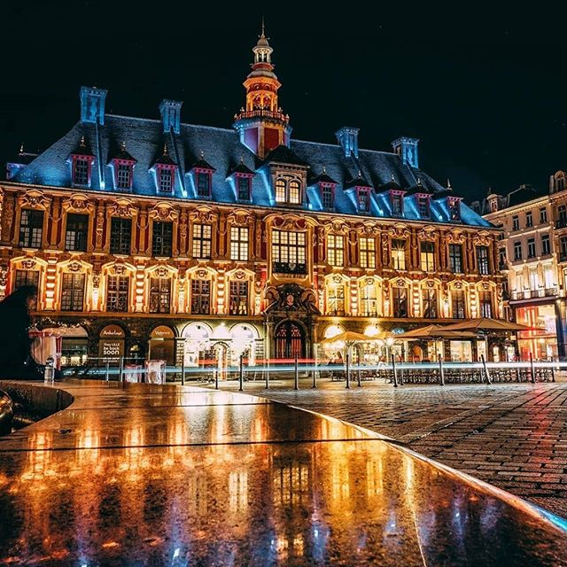

Style Transfert Principe
Style image
Input image
Content Image

Slide 3
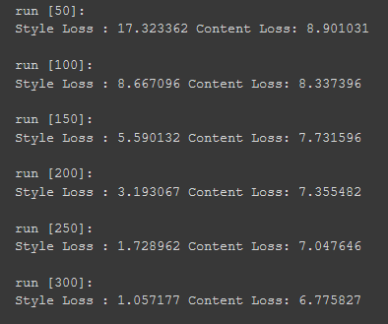
Loss functions
To make this happen, we have to reduce distances between styles and contents
For that, we define 2 loss functions
The Content loss
The Style loss
We will try to minimize these 2 weighted losses

Slide 4

Distances
Very important machine learning notion
It define the similarities between datas
Usefull in unsupervised learning and semi-supervised learning

Slide 5

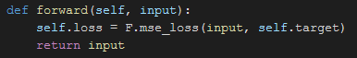
Content loss
We fed our model with our input image and our content image
We take, for each image, our model output features
We compute the mean square error between those features map

Slide 6
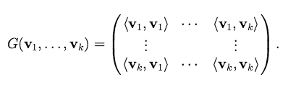

Style Loss
Weighted representation of the style difference between our input and style image
Compute the gram matrix of our feature layers
Compute the gram matrix of our style image feature
Compute the mean square error between them
Make this computation with several layers to increase the precision

Slide 7

Employed method
Classic Machine Meanring method
Data aquisition
Computing part
Results

Slide 8

Data collection
We wrote an Instagram Scrapper to collect our images without signing in
We download few images in full size
Automatic scroll on the page before you signing in

Slide 9

Computing part
Classic Classifier (VGG19)
Training loop
Feed our classifier with the content and style image
Compute the content and the style loss
Backpropagate on our input image using LBFGS optimizer

Slide 10
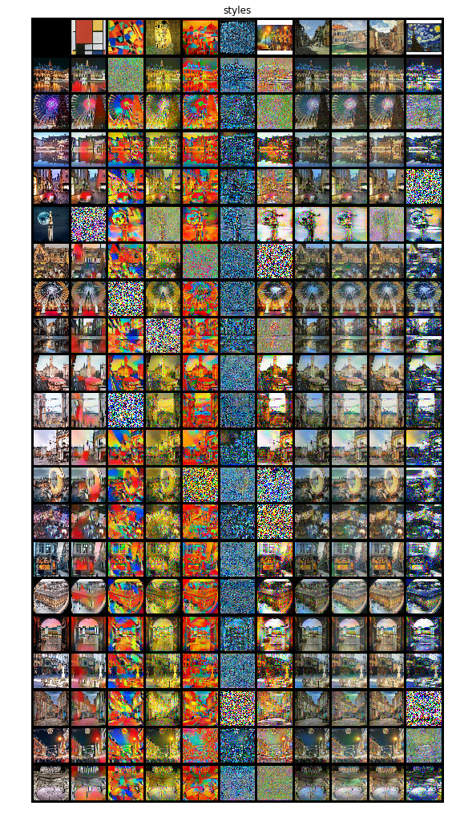
Find the best combination

Slide 11
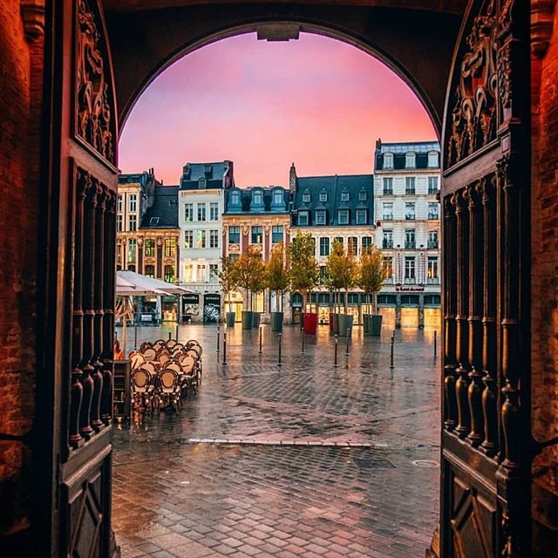
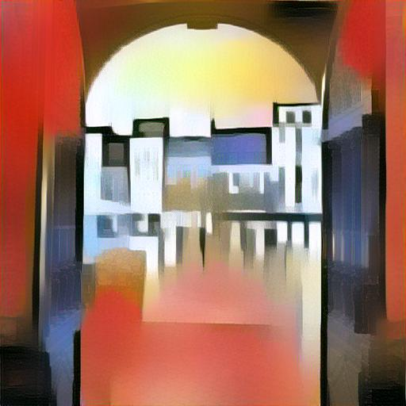
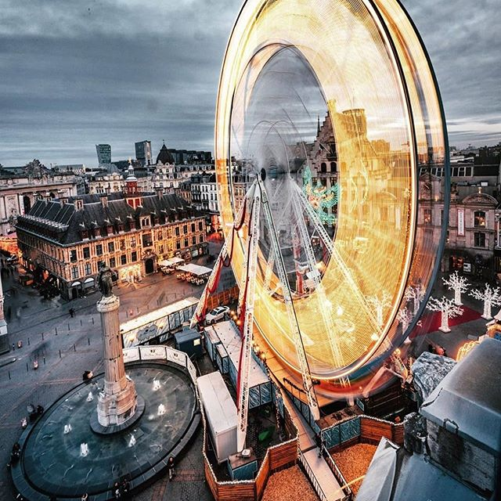
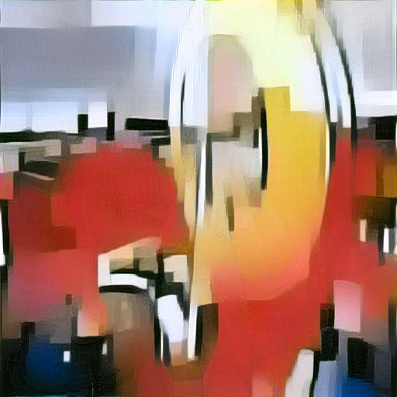
Results
To get the best image, we try to compute every combination between our style content images

Slide 12
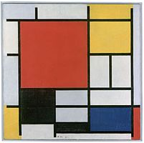
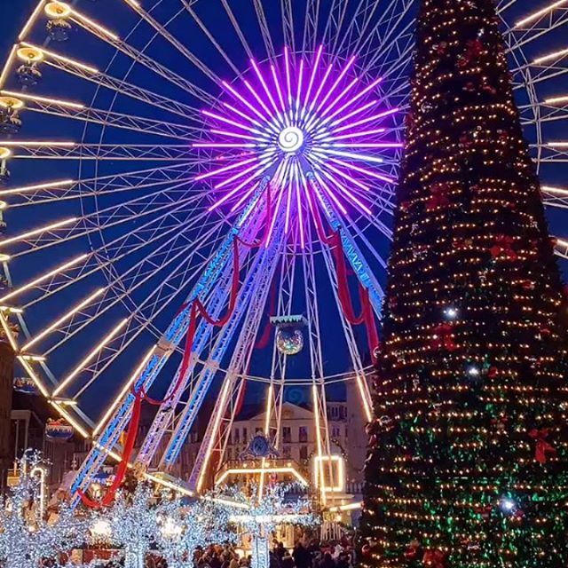
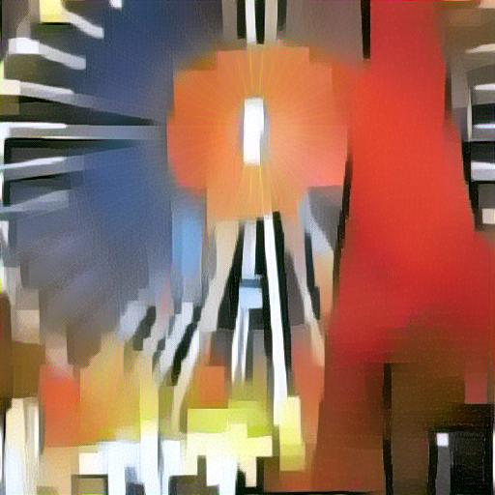
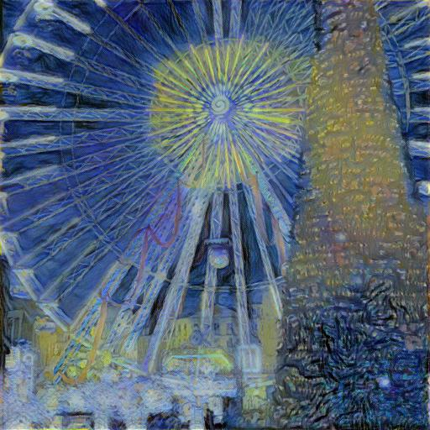
Results : Hyphothesis
If style and content images are too uncorrolated => Bad results

Slide 13
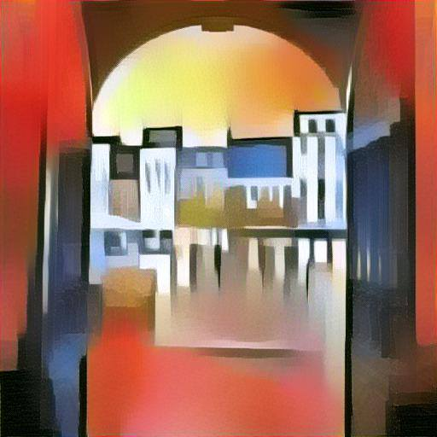
Results
Other tests with annoter model (VGG16)
More blurred style
Less abstract style

Slide 14
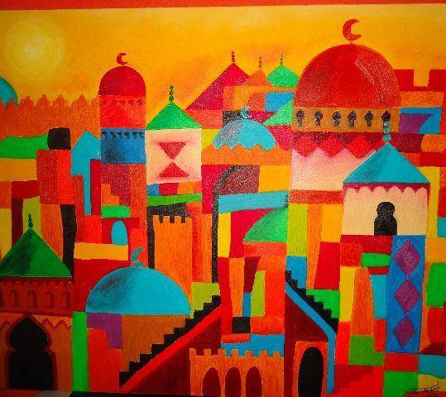
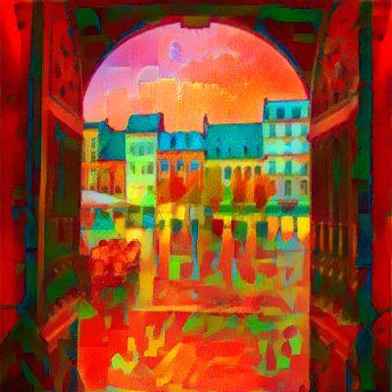
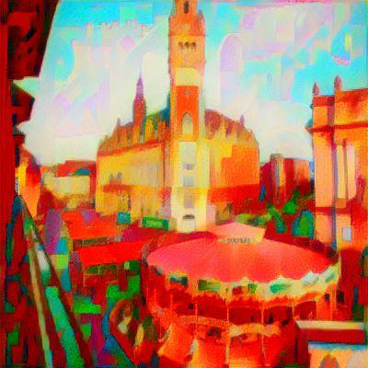
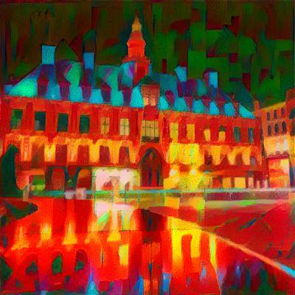
Results

Slide 15
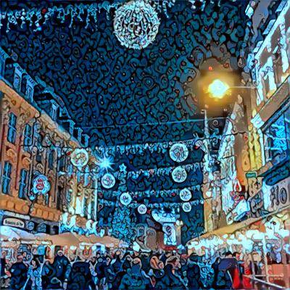
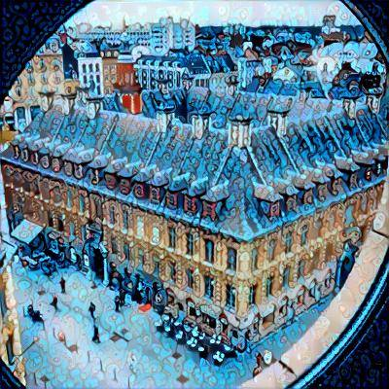
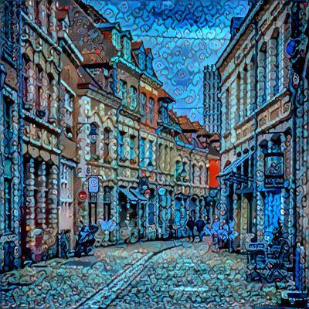
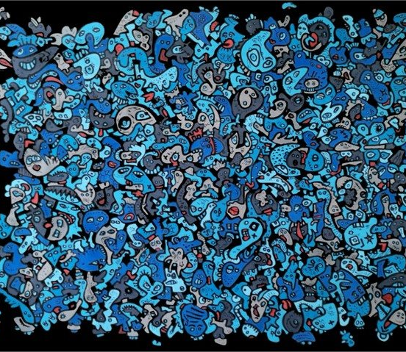
Results

Slide 16
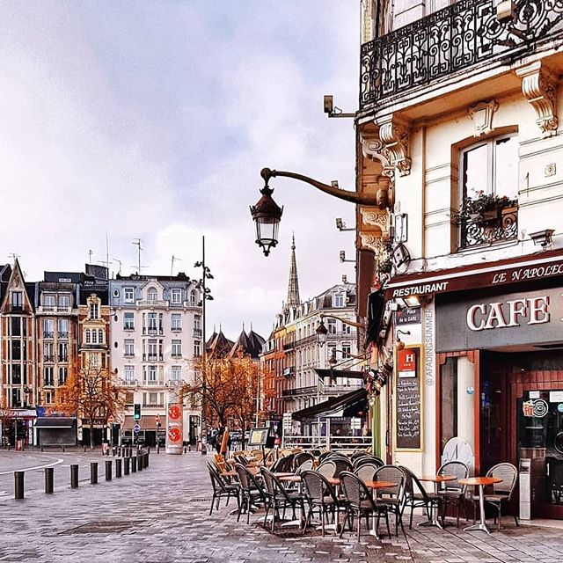
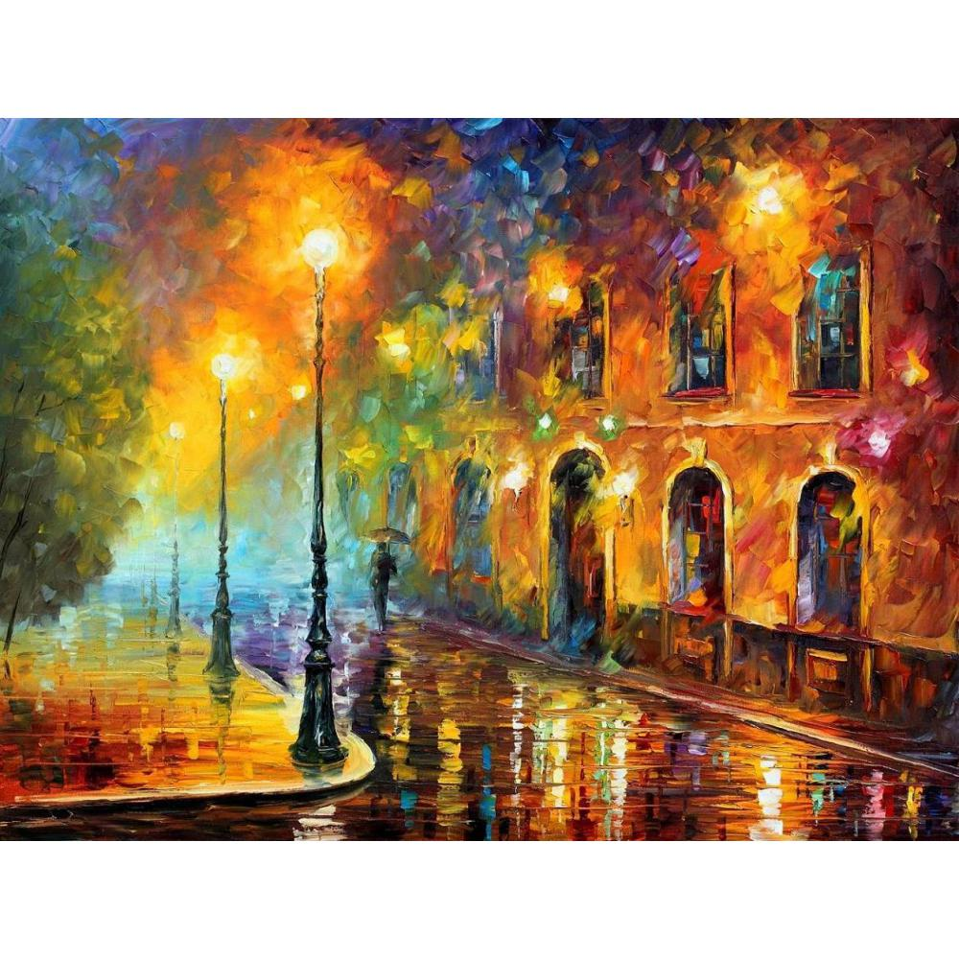
The end

